Slide 1
Using Software Defined Radio to annoy your neighbors
Nikolaos Virvilis

Slide 2
#whoami
Nikos Virvilis
Cyber Security Background
Not an RF Engineer
Using (exploiting) SDR capabilities for Cyber Security / Penetration Testing

Slide 3
Radio & Software defined Radio
Traditional radio equipment:
Designed for a specific purpose
Good luck trying to receive satellite signals with an FM Radio

Slide 4
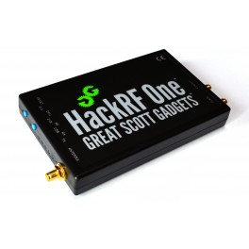
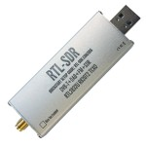
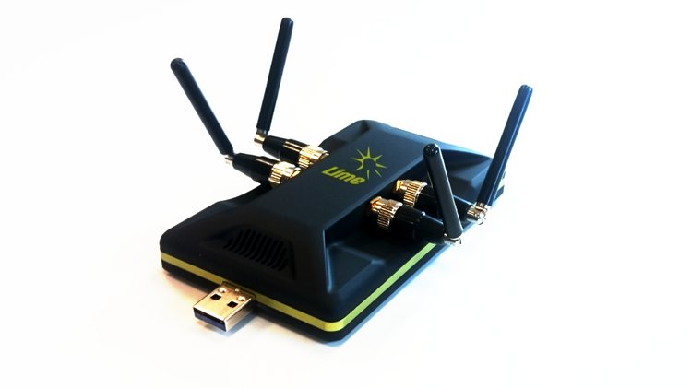
Software Defined Radio
RF Receivers or Transceivers
RF (Analog) Input from Antenna → Amplification → Analog to Digital Conversion → Computer
Everything else is performed in software

Slide 5
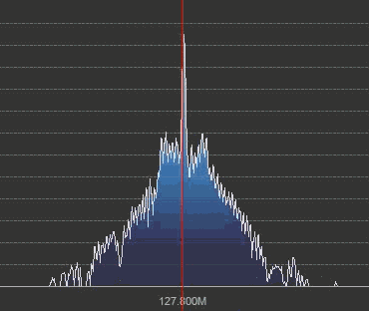
What can you do
Listen to FM radio (wow!)
Watch digital TV
Mess up with your neighbors ☺
Track airplanes by monitoring their radio transmissions (ADS-B) protocol
Ships too!
Passive radar (you need 2 SDR dongles and two antennas)
Btw you can detect “stealth” planes with this
Listen to Law Enforcement (including TETRA radios), taxi, ham radio etc.

Slide 6
What can you do (cont.)
Spoof GPS. Suddenly Google maps tells you that you are in Jamaica
You can even steal a nice boat ☺
Sniff GSM traffic
Jam Stuff (alarm systems, home automation, etc.)
Unlock Cars
And much much more.

Slide 7
Go cheap
RTL – SDR
Digital TV receiver
20 USD
Use of special drivers allows you to monitor from 24 – 1766 MHz
R820T2 tuner is considered the best
E4000 tuner (older chipset): Not so sensitive but can receive 52 – 2200 MHz with a gap from 1100 MHz to 1250 MHz
Receive Only
2 MHz bandwidth
Excellent community support

Slide 8
A bit more expensive
HackRF One
Receive AND Transmit
1 MHz to 6 GHz operating frequency
20 Mhz bandwidth
Half – Duplex (i.e. you cannot run OpenBTS ☹)
300 – 330 euros
30 mW (15 dBm) max transmit power
Very good community support

Slide 9
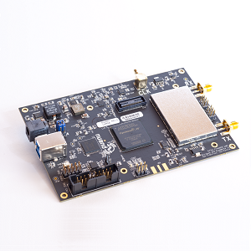
Even more expensive
BladeRF
Receive AND Transmit
300MHz - 3.8GHz operating frequency
28 Mhz bandwidth
Full – Duplex (i.e. you can run OpenBTS ☺)
420 USD (small fpga) – 650 USD (large fpga)
4mW (6 dBm) max transmit power
Limited community support

Slide 10
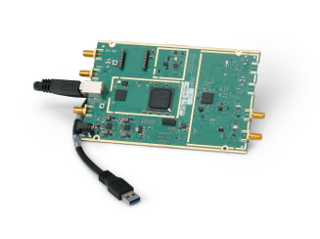
Pro
USRP B200
The cheapest of the USRP line
Receive AND Transmit
70MHz - 6GHz operating frequency
56 Mhz bandwidth
Full – Duplex (i.e. you can run OpenBTS ☺)
100mW max transmit power
Decent community support

Slide 11
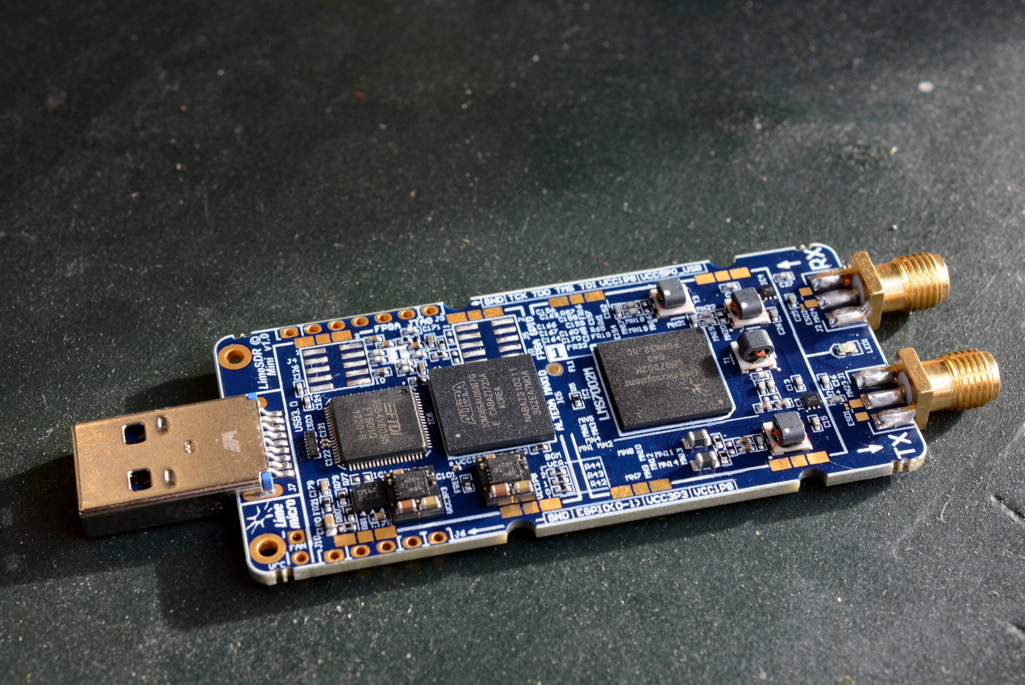
(New) kid in the block
LimeSDR / LimeSDR mini
Just released, preliminary reviews are very promising.
It is expected to be comparable to USRP B200 / USRP B210 but at a fraction of the cost
Frequency range: 100 kHz – 3.8 GHz
Bandwidth: 61.44 MHz
Full duplex with 1 or 2 TX/ 1 or 2 RX interface
10mW transmit power

Slide 12
DEMO

Slide 13
Radio
GQRX

Slide 14
ADS-B
Fine tuned rtl-sdr sticks with integrated Low Noise Amplifier (LNA)
https://flightaware.com/adsb/prostick/
Decent antenna
(Almost) plug and play on a raspberry pi
https://flightaware.com/adsb/piaware/

Slide 15
ADS-B – My Node

Slide 16
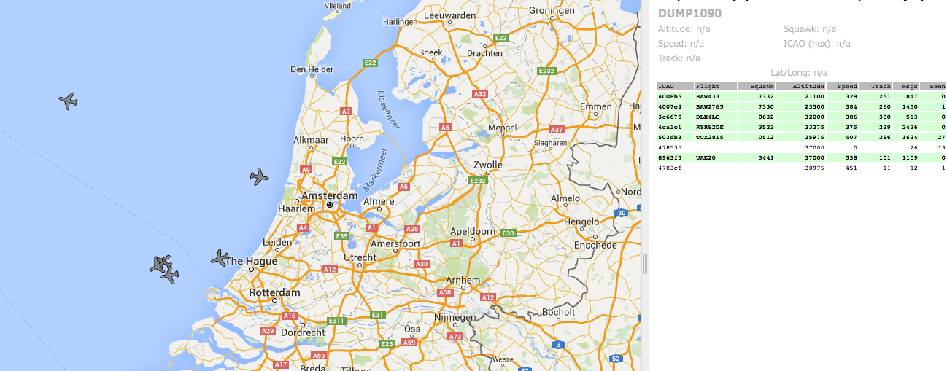
ADS-B https://github.com/gvanem/Dump1090

Slide 17
GSM Traffic

Slide 18
Hello ☺

Slide 19
Capture and Replay
(demo)

Slide 20
JAM
(demo)

Slide 21
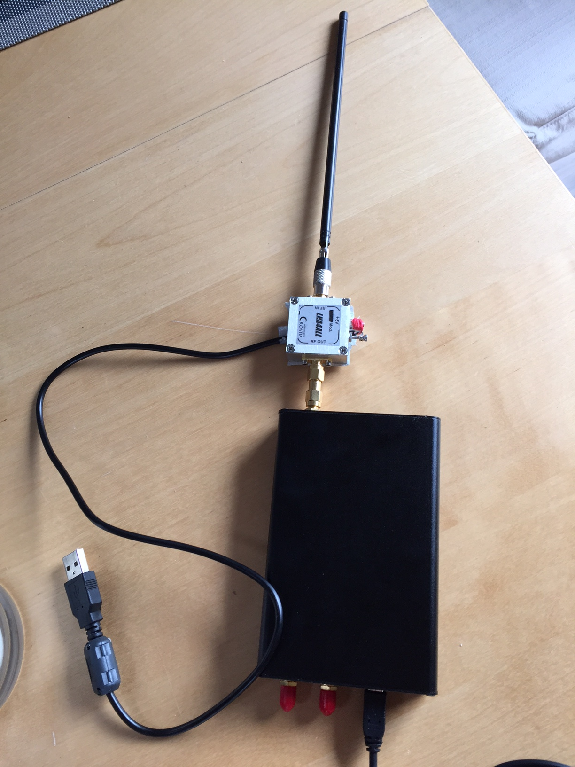
It’s all about TX power
HackRF: About 15 dBm (31 mW)
Most Wifi AP’s transmit with 50-100mW
Even if the transmitter transmits with less that 31 mW, if it is closer to the receiver than the HackRF, you might not be able to jam the signal
TX Amplifier to the rescue!

Slide 22
Conclusion
SDR has drastiscally lowered the bar for radio applications
For both legitimate and nefarious purposes
Review your Cyber Security posture, considering the low cost attacks that SDR introduces

Slide 23
Questions
?

Slide 24
Resources
https://gqrx.dk/
https://github.com/gvanem/Dump1090
https://flightaware.com/adsb/prostick/
https://github.com/sq5bpf/osmo-tetra-sq5bpf
https://github.com/ptrkrysik/gr-gsm
https://www.youtube.com/watch?v=BeeSN14JUYU&list=PLu0BPYzTjiHru1KmPThmbY-8rRm3EWvUQ
https://github.com/merbanan/rtl_433
https://github.com/mossmann/hackrf

